Slide 1

OpenAI API
Chat Playground
Notes:
https://gemini.google.com/app

Slide 2
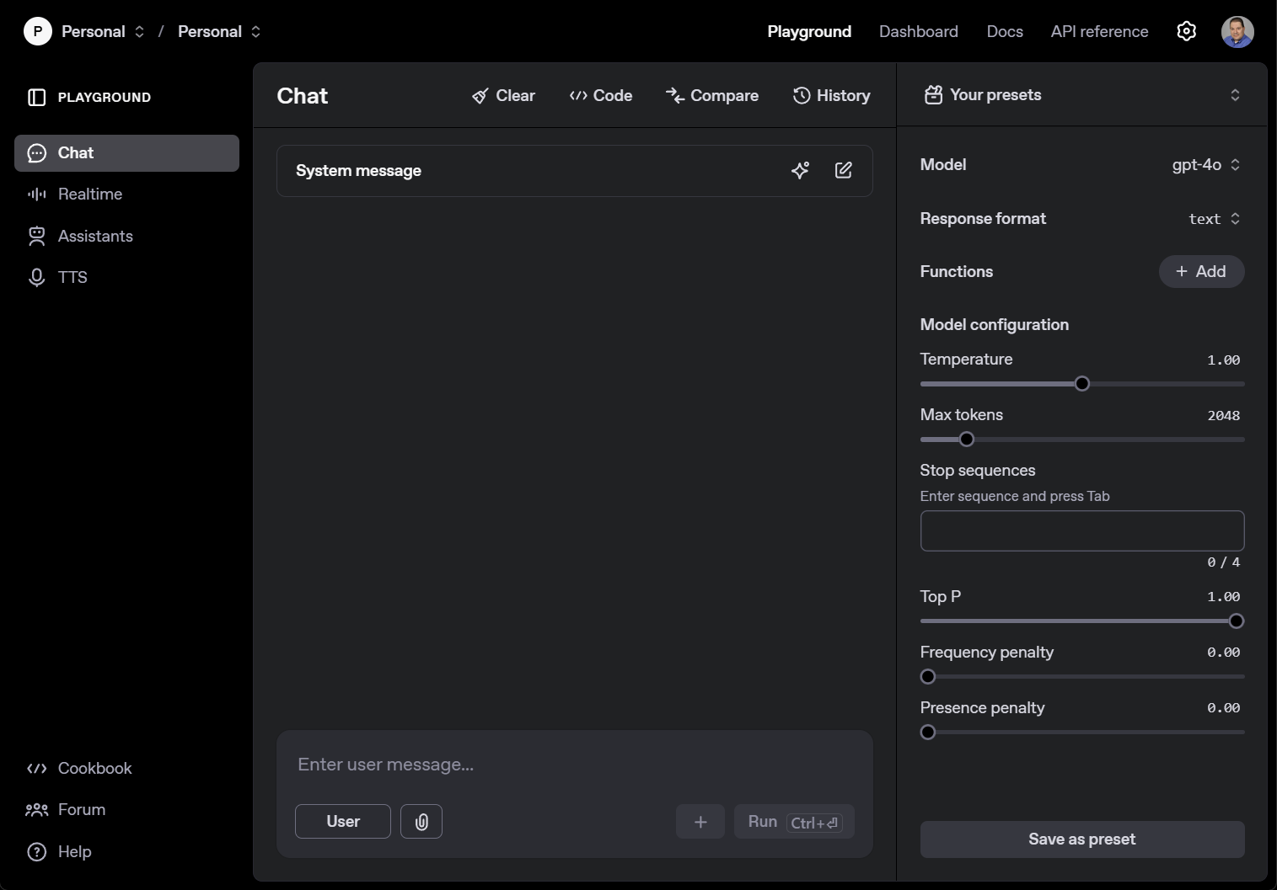

Slide 3


Slide 4
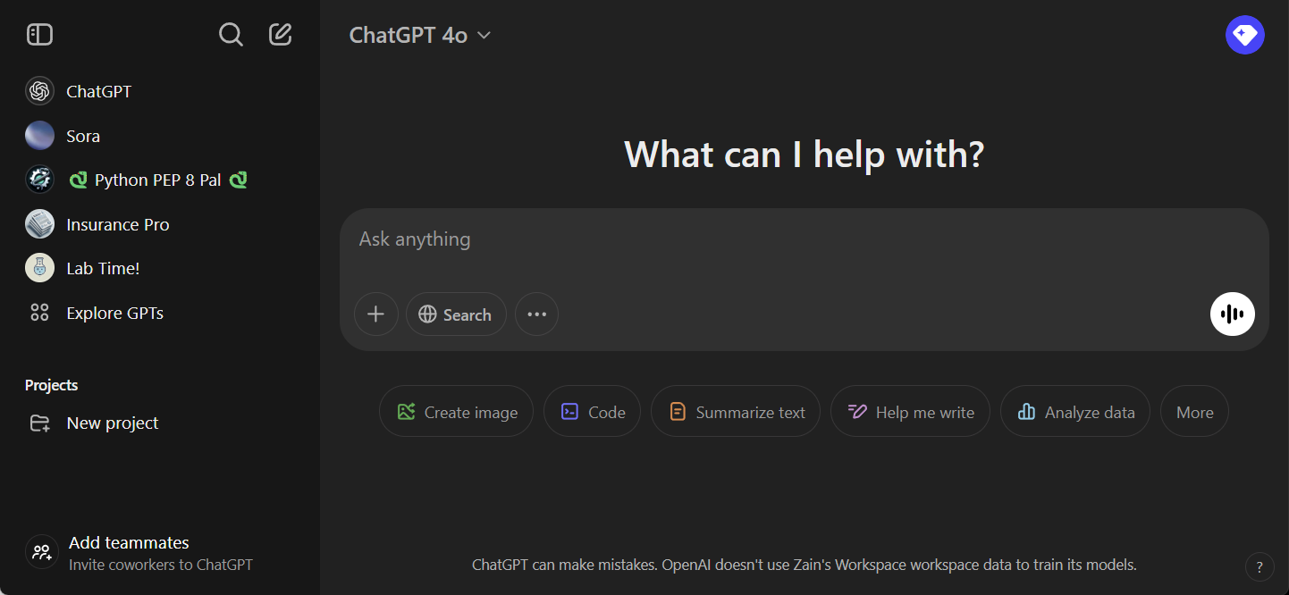
PSA: Chat Completions are NOT ChatGPT

Slide 5
Arriving at the Chat Playground

Slide 6
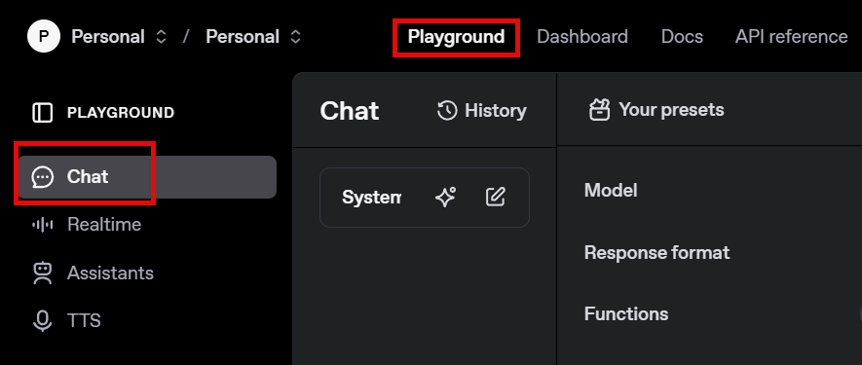

Slide 7


Doing a “Turn”
User
Assistant

Slide 8
DEMO: Single Turn Conversation
Notes:
User: What is a penguin?

Slide 9
Multi-Turn Conversations
User
Assistant
User
Assistant
User
Assistant

Slide 10
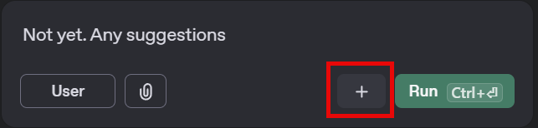
Multi-Turn Conversations

Slide 11
DEMO: Multi-Turn Conversation
Notes:
User: Hello.
Assistant: Hello, how are you? User: I'm fine, how are you today?
Assistant: I’m feeling great! Have you had your caffeine today?
User: Not, yet. Any suggestions?

Slide 12

Clearing Conversations

Slide 13
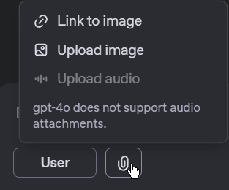
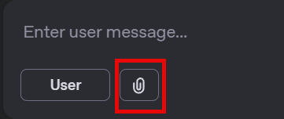

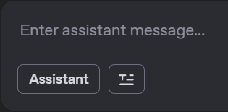

Adding Attachments & Links to Images

Slide 14
DEMO: Adding a Link
Notes:
https://i.guim.co.uk/img/media/c992281c1667d21317eb3a0a1b74cebd2d48d8a6/0_380_5611_3368/master/5611.jpg?width=1200&height=900&quality=85&auto=format&fit=crop&s=8dbaf697f722331625a15c22d44dcb54

Slide 15
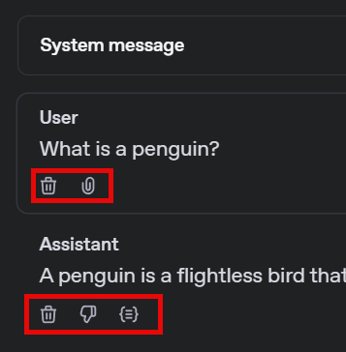
User & Assistant Message Tools

Slide 16
DEMO: User & Assistant Message Tools

Slide 17

Code, Compare, & History

Slide 18
DEMO: Code, Compare, & History
Notes:
After you generate the code, there is nothing to show the response. Use the line below to show the response.
print(response.choices[0].message.content)

Slide 19
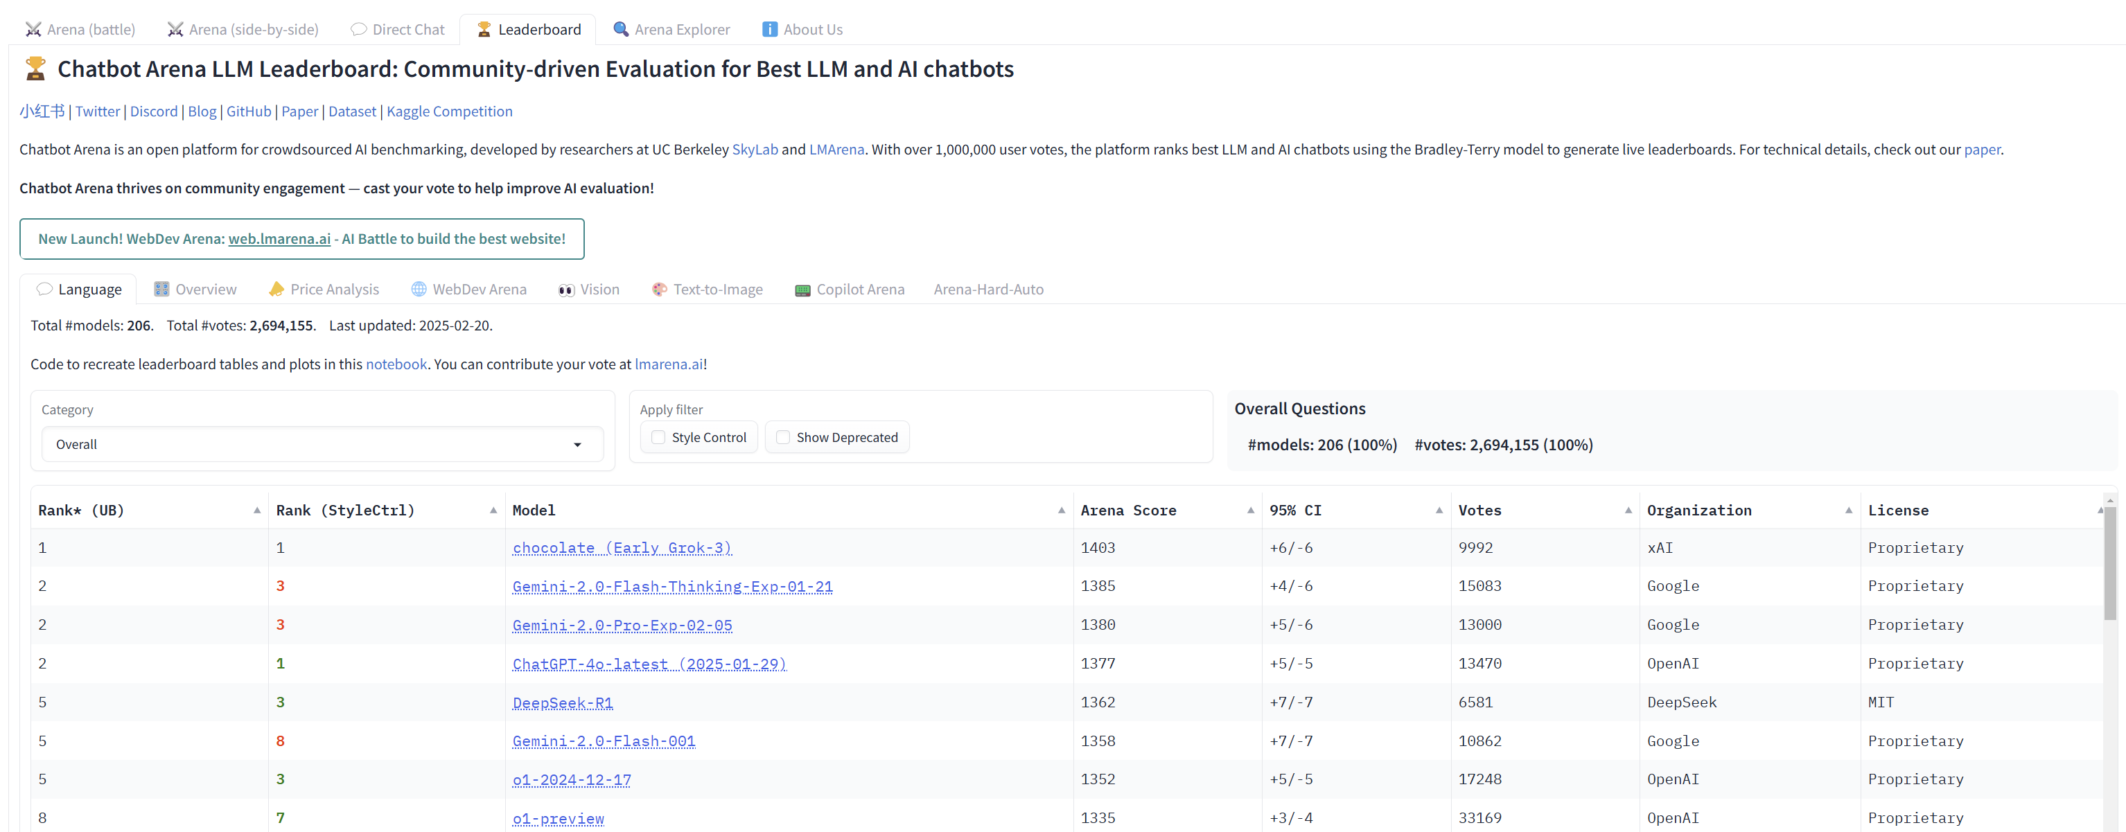
LMArena.AI
Notes:
https://lmarena.ai/

Slide 20
DEMO: LM Arena
Notes:
https://lmarena.ai/

Slide 21




Notes:
https://www.youtube.com/channel/UC35ZpwldGw7ZJ5R-2sLijzw

Slide 22
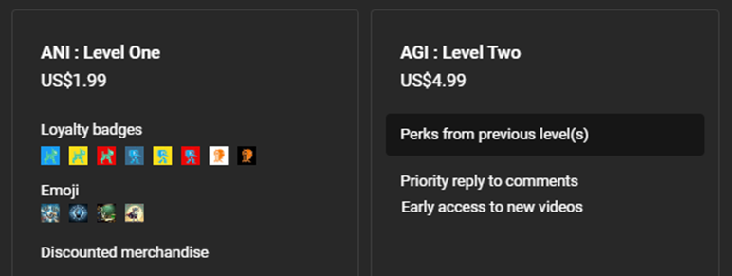
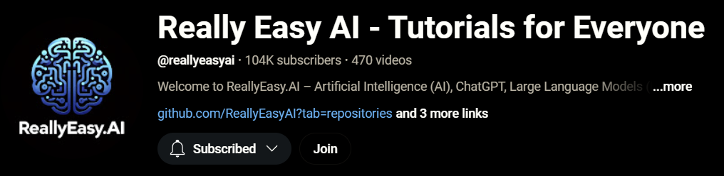
Notes:
https://www.youtube.com/@reallyeasyai/join

Slide 23
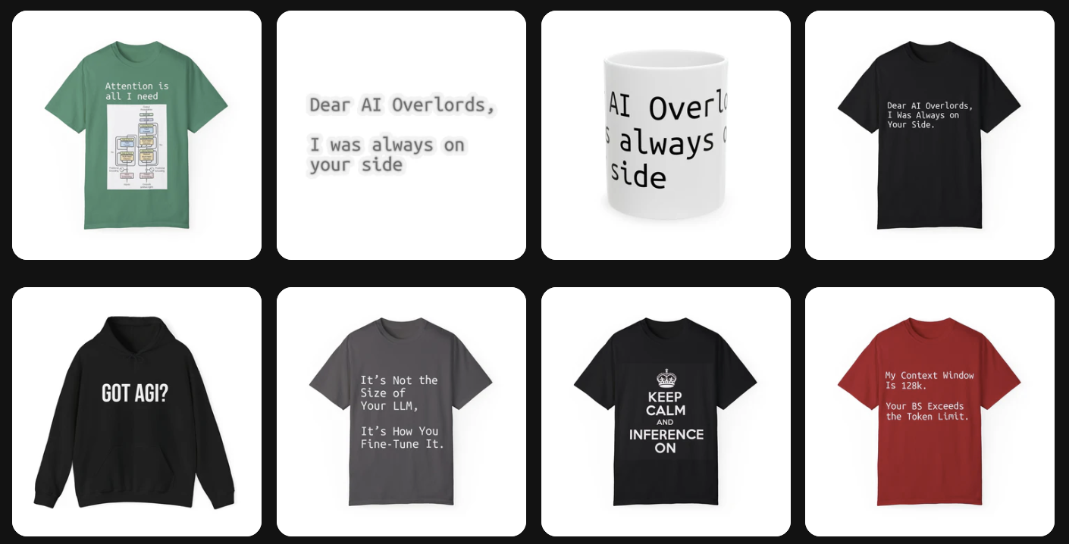
https://shop.reallyeasy.ai
Notes:
https://shop.reallyeasy.ai

Slide 24

https://www.youtube.com/@ainewsfresh
Notes:
https://www.youtube.com/@ainewsfresh

Slide 25
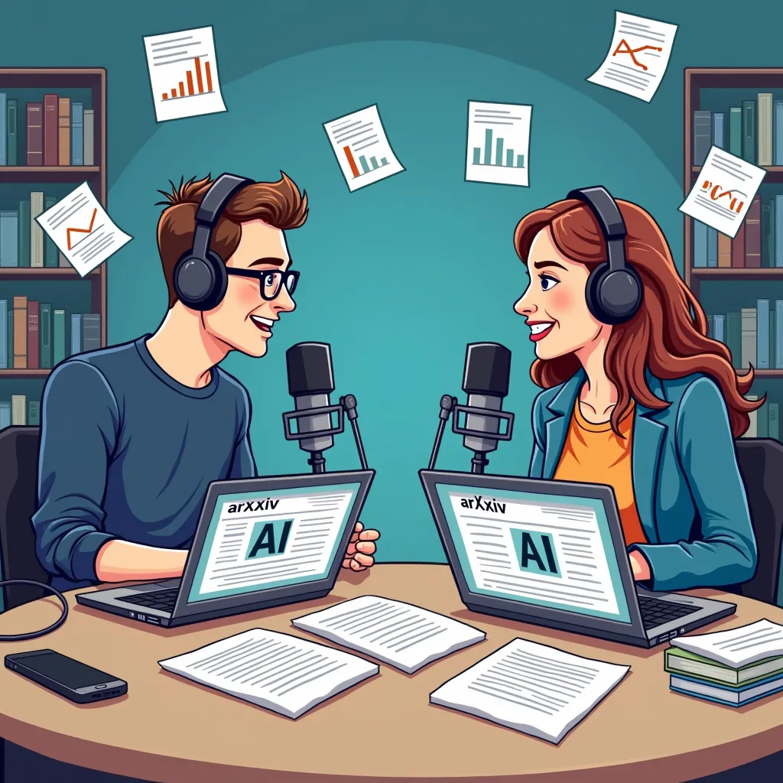
https://www.youtube.com/@aipaperspodcastdaily
Notes:
https://www.youtube.com/@aipaperspodcastdaily

Slide 26

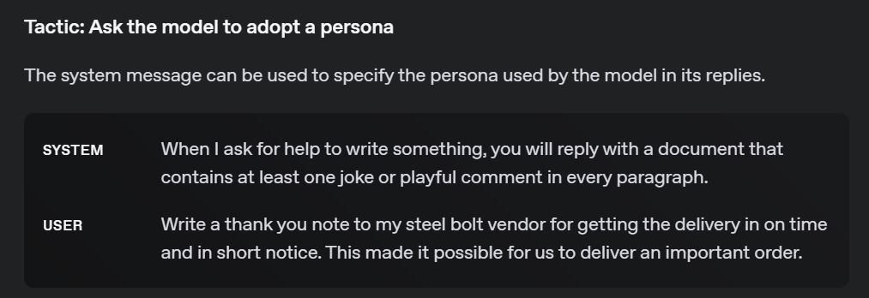
System Message

Slide 27
DEMO: System Message
Notes:
System message: Put the word "meow" at the end of every sentence.
User: What is a penguin?
System message: You are a pirate.
User: What is a penguin?
System message: You are a customer support chatbot for ACME Inc. Always provide polite, concise, and helpful responses. If a customer asks about refunds, inform them that refunds are processed within 5-7 business days. Do not provide legal or medical advice.
User: I ordered a product last week, but I still haven't received it. What should I do?

Slide 28
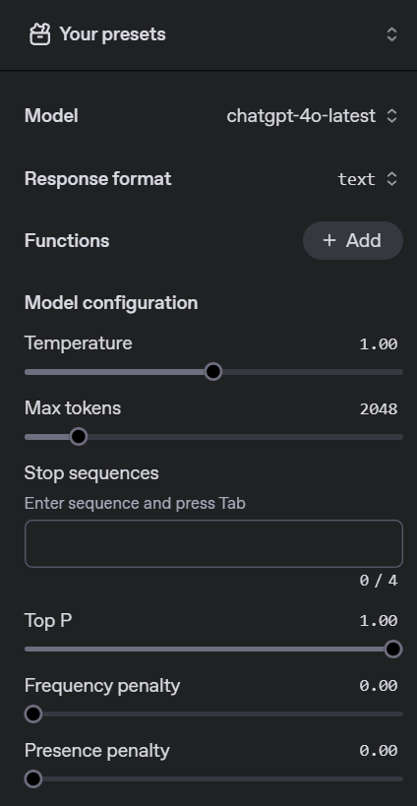
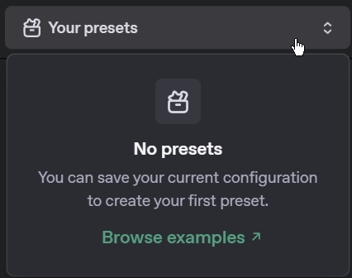
Presets & Other Settings

Slide 29
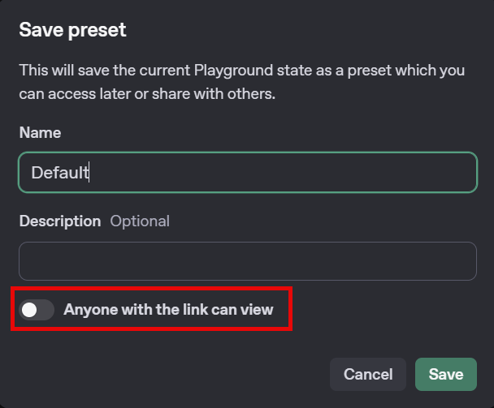
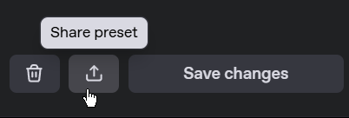
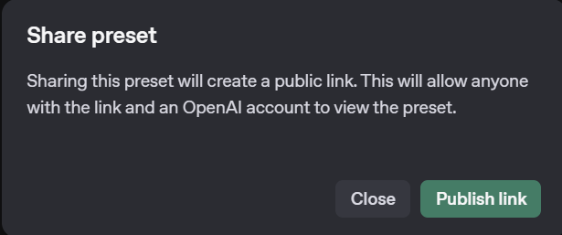
Sharing Presets

Slide 30
DEMO: Presets

Slide 31
OpenAI API
Chat Playground
Notes:
https://gemini.google.com/app

